Slide 1
MODULE-4
Maintenance Relevance – Value Redefinition - Extreme Competition Experience Design - Standardization

Slide 2
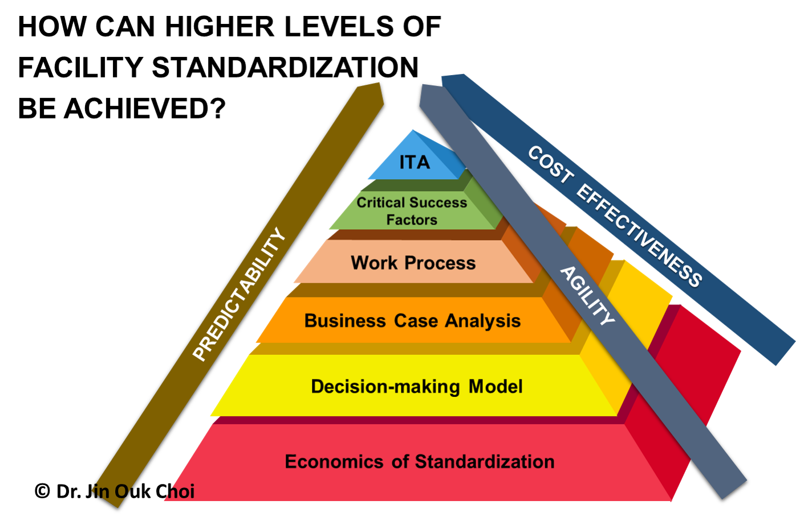
Introduction
Maintenance Relevance, Value Redefinition, Extreme Competition Experience Design, and Standardization are crucial concepts in the business landscape.
Understanding these topics can help organizations stay competitive and relevant in today's fast-paced environment.
This presentation will explore the significance of each concept and provide insights on how to leverage them effectively.
1
Notes:
Image source: https://jchoi.faculty.unlv.edu/pmcel/standardization-strategy/

Slide 3
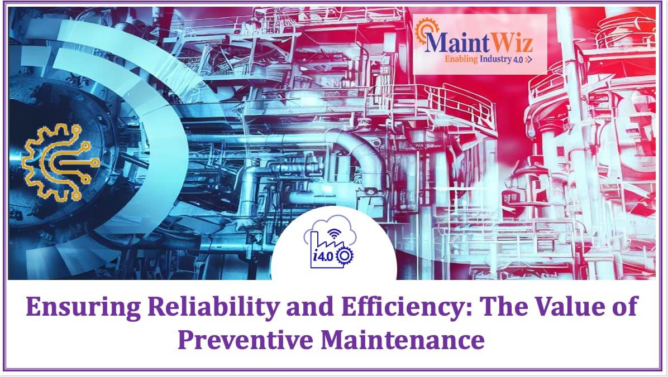
Maintenance Relevance
Maintenance plays a critical role in ensuring the longevity and efficiency of assets and equipment.
Proactive maintenance strategies can help prevent costly breakdowns and downtime.
Incorporating predictive maintenance technologies can further optimize maintenance processes and reduce operational risks.
2
Notes:
Image source: https://www.maintwiz.com/blog/ensuring-reliability-and-efficiency-the-value-of-preventive-maintenance/

Slide 4
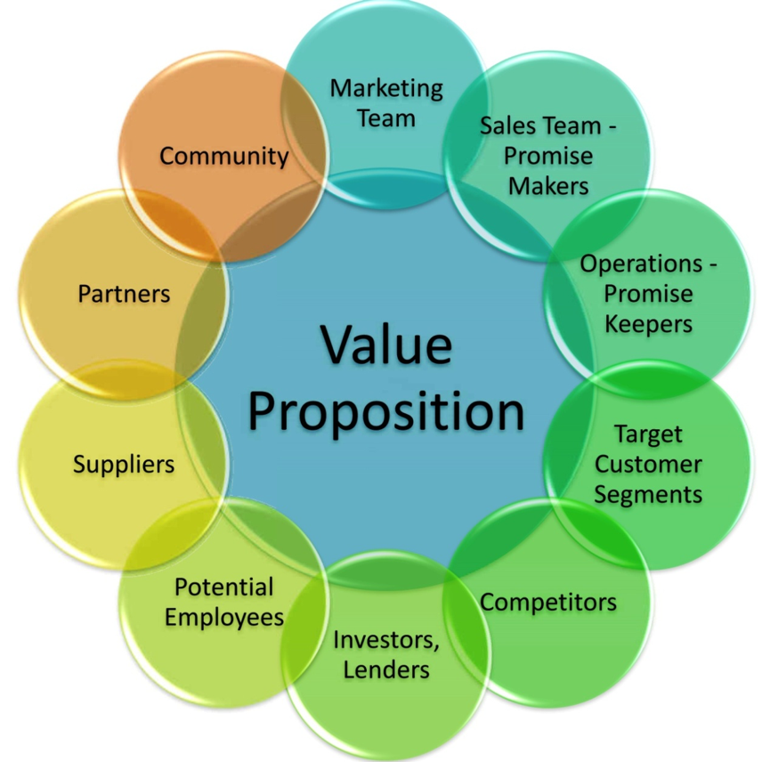
Value Redefinition
Value redefinition involves reassessing and realigning the value proposition of products or services.
By understanding changing customer needs and market trends, organizations can redefine value to stay competitive.
Value redefinition can lead to increased customer satisfaction, loyalty, and differentiation in the market.
3
Notes:
Image source: https://wordflirt.com/ten-audiences-value-proposition/

Slide 5
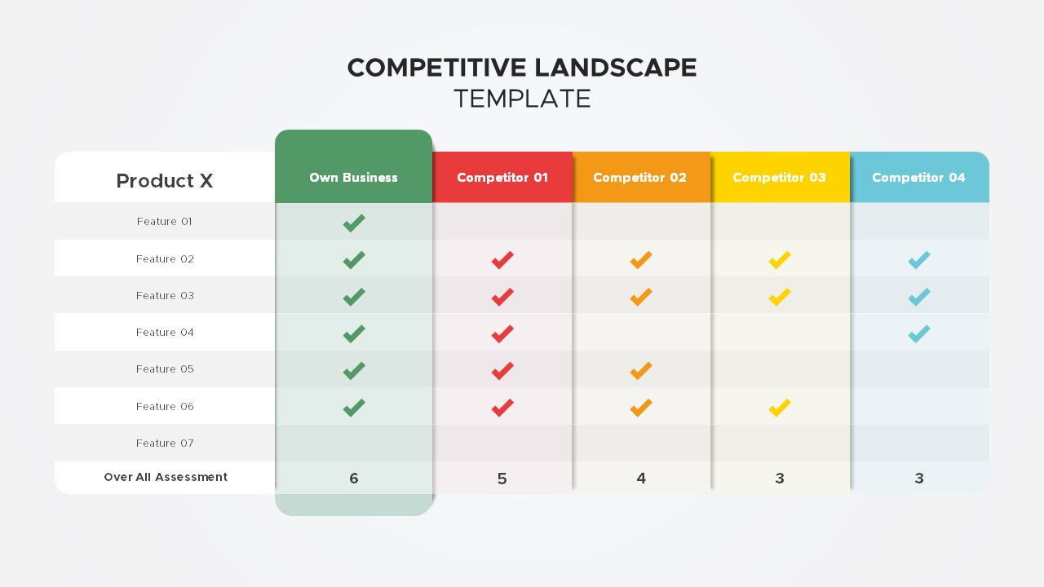
Extreme Competition Experience Design
In today's hyper-competitive landscape, providing exceptional customer experiences is paramount.
Extreme competition experience design focuses on creating memorable and engaging experiences for customers.
By prioritizing customer-centric design and personalization, organizations can differentiate themselves and build brand loyalty.
4
Notes:
Image source: https://slidebazaar.com/items/competitive-landscape-slide/

Slide 6

Standardization
Standardization involves establishing uniform processes, practices, or products across an organization.
Standardization can improve efficiency, quality, and consistency in operations.
Implementing standardized protocols and procedures can streamline workflows, enhance collaboration, and drive continuous improvement.
5
Notes:
Image source: https://www.animalia-life.club/qa/pictures/standardization

Slide 7
Integrating Concepts
Integrating maintenance relevance, value redefinition, extreme competition experience design, and standardization can create a powerful competitive advantage.
By aligning these concepts with organizational goals and strategies, businesses can drive innovation and sustainable growth.
Leveraging a holistic approach to these concepts can foster a culture of continuous improvement and adaptability.
6
Notes:
Image source: https://www.researchgate.net/figure/Framework-assessing-and-improving-maintenance-data-quality_fig1_226335888

Slide 8
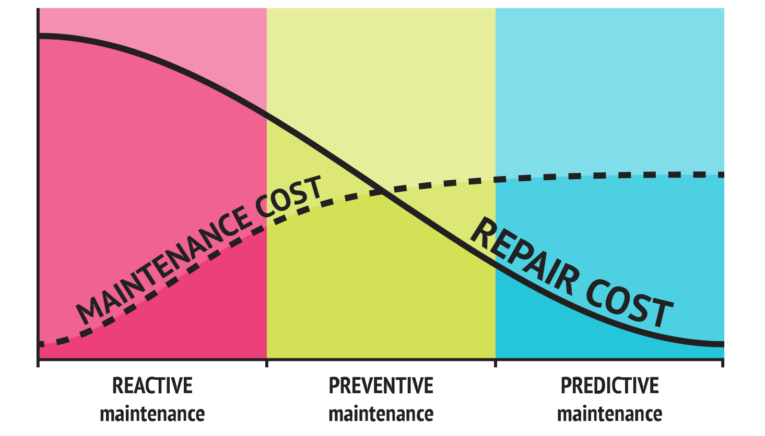
Case Study: Company X
Company X implemented predictive maintenance strategies to optimize asset performance and reduce downtime.
Through value redefinition efforts, Company X enhanced its product offerings to better meet customer needs and preferences.
Company X prioritized extreme competition experience design, leading to increased customer satisfaction and brand loyalty.
7
Notes:
Image source: https://www.altexsoft.com/blog/predictive-maintenance/

Slide 9
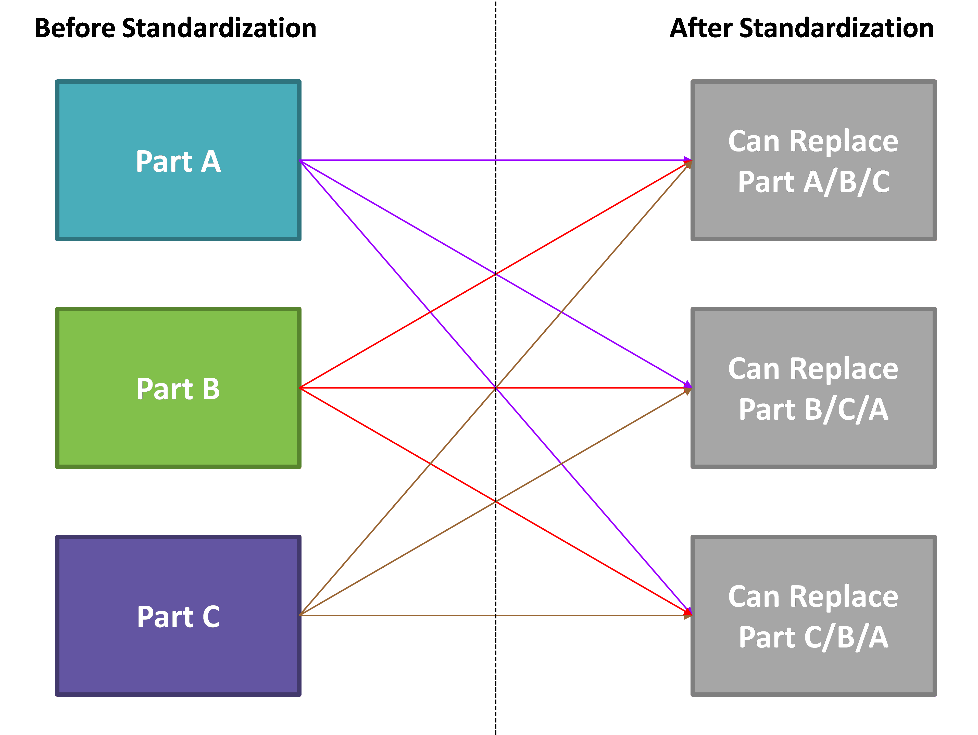
Case Study: Company Y
Company Y embraced standardization across its operations, resulting in improved efficiency and cost savings.
By redefining its value proposition, Company Y differentiated itself in the market and attracted new customers.
Company Y's focus on maintenance relevance led to enhanced asset reliability and reduced maintenance costs.
8
Notes:
Image source: http://childhealthpolicy.vumc.org/fogozywu7431.html

Slide 10

Key Benefits
Embracing maintenance relevance can lead to improved asset performance and reduced downtime.
Value redefinition can enhance customer satisfaction, loyalty, and competitive positioning.
Extreme competition experience design can drive brand differentiation and customer engagement.
9
Notes:
Image source: http://www.iso55001guide.com/benefits-of-iso-55001/

Slide 11
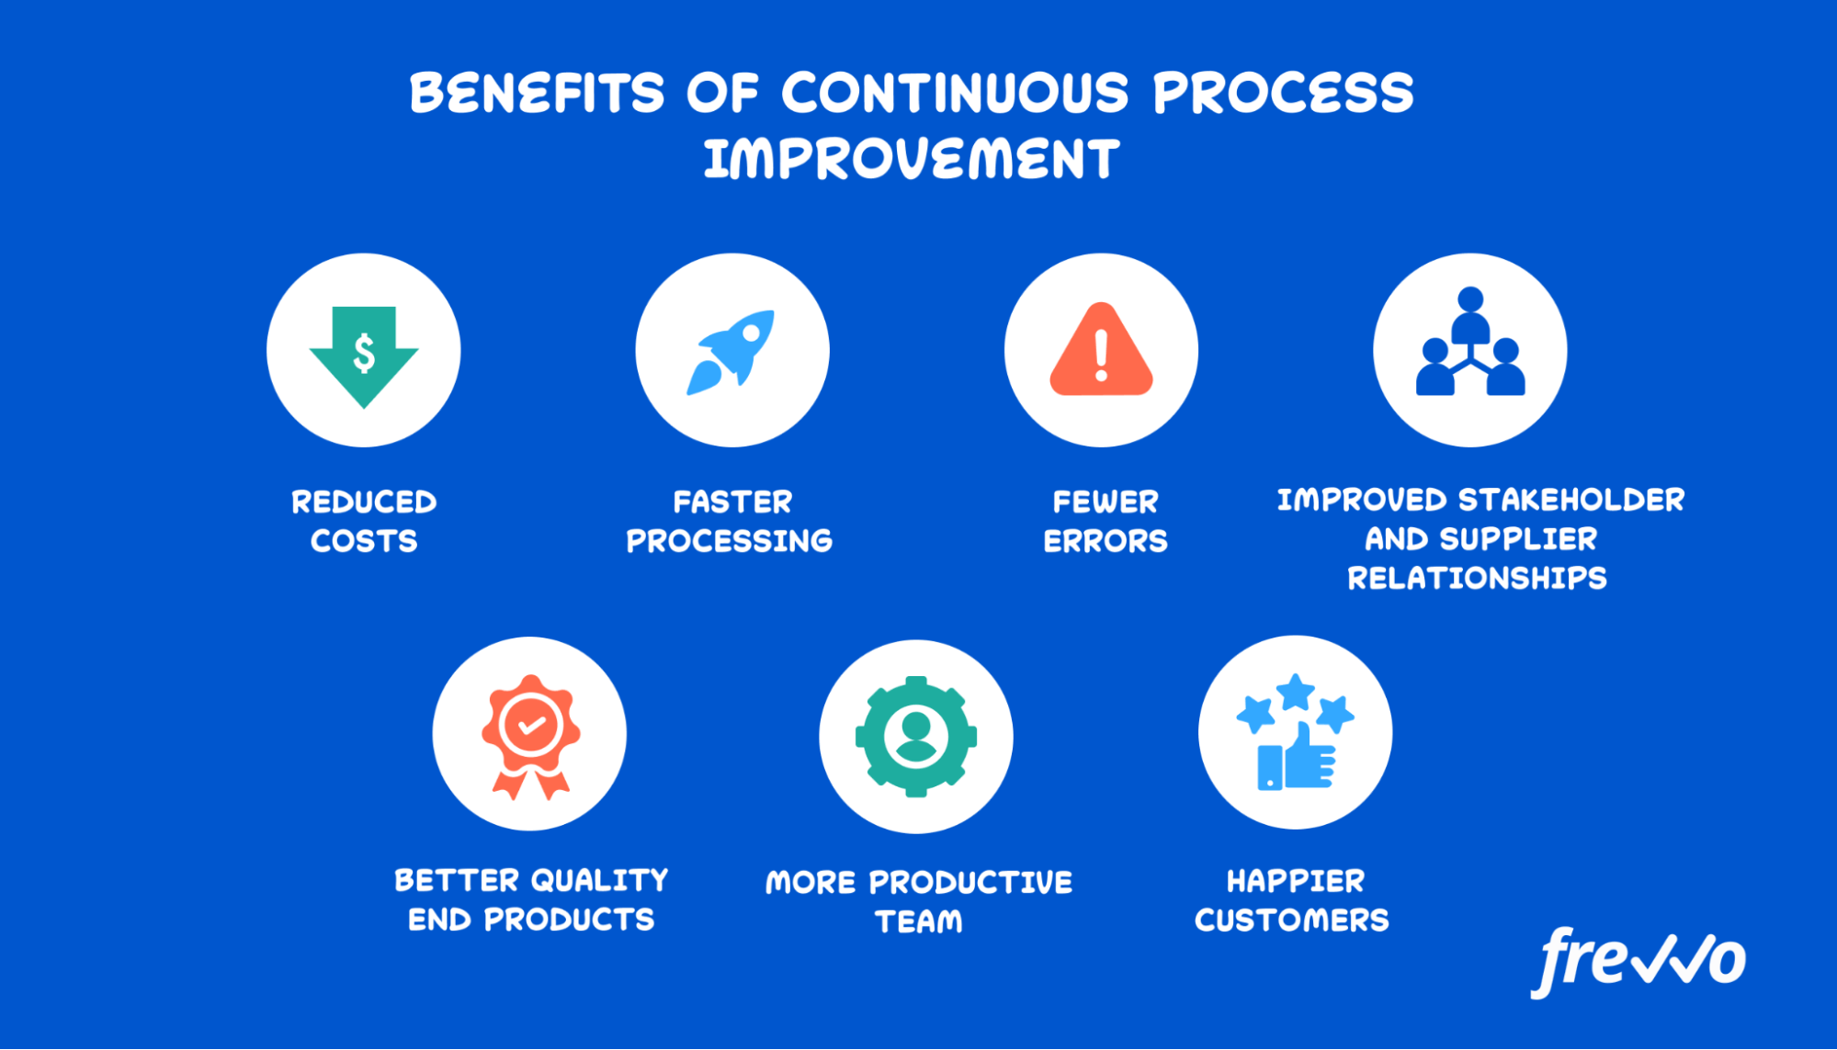
Key Benefits (cont'd)
Standardization can streamline operations, improve quality, and drive continuous improvement.
Integrating these concepts can create a synergistic effect, leading to enhanced competitiveness and sustainable growth.
Organizations that prioritize these concepts are better positioned to adapt to market dynamics and emerging trends.
10
Notes:
Image source: https://www.frevvo.com/blog/continuous-process-improvement/

Slide 12
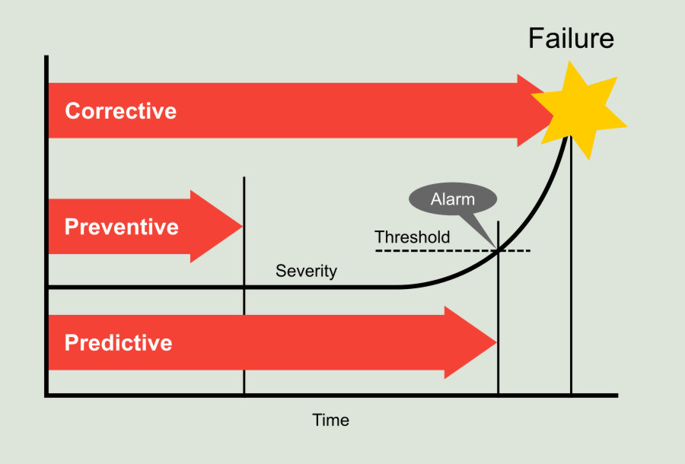
Challenges
Implementing maintenance relevance strategies may require investment in predictive maintenance technologies and training for maintenance teams.
Redefining value can be challenging, as it requires a deep understanding of customer preferences and market trends.
Designing extreme competition experiences may involve significant resources and a shift in organizational culture.
11
Notes:
Image source: https://power-mi.com/content/maintenance-strategies

Slide 13
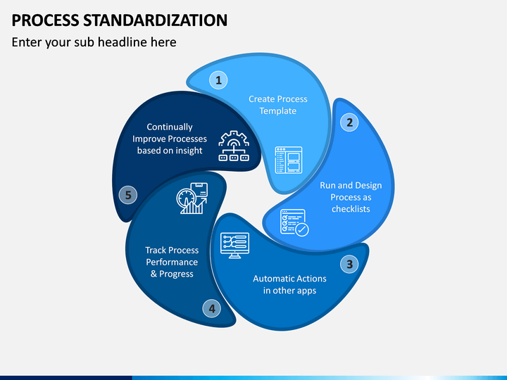
Challenges (cont'd)
Standardizing processes across an organization can be met with resistance from employees accustomed to existing practices.
Balancing the need for standardization with the flexibility to adapt to changing market conditions can be a challenge for organizations.
Overcoming these challenges requires strong leadership, effective communication, and a commitment to continuous improvement.
12
Notes:
Image source: https://www.sketchbubble.com/en/presentation-process-standardization.html

Slide 14
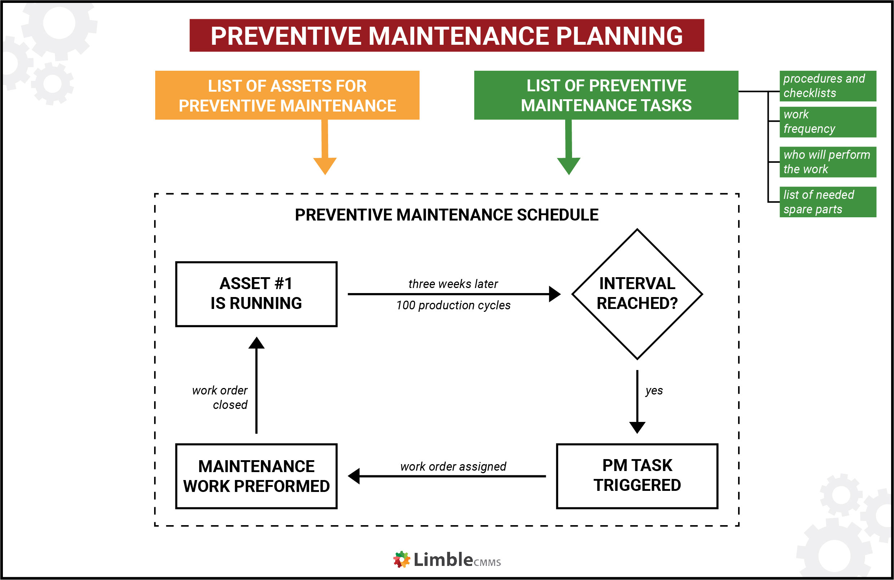
Best Practices
Develop a comprehensive maintenance strategy that combines preventive, predictive, and proactive maintenance approaches.
Continuously monitor key performance indicators to assess the effectiveness of maintenance efforts and identify areas for improvement.
Invest in training and upskilling maintenance teams to leverage new technologies and best practices.
13
Notes:
Image source: https://nehrumemorial.org/preventive-maintenance-system-record/

Slide 15
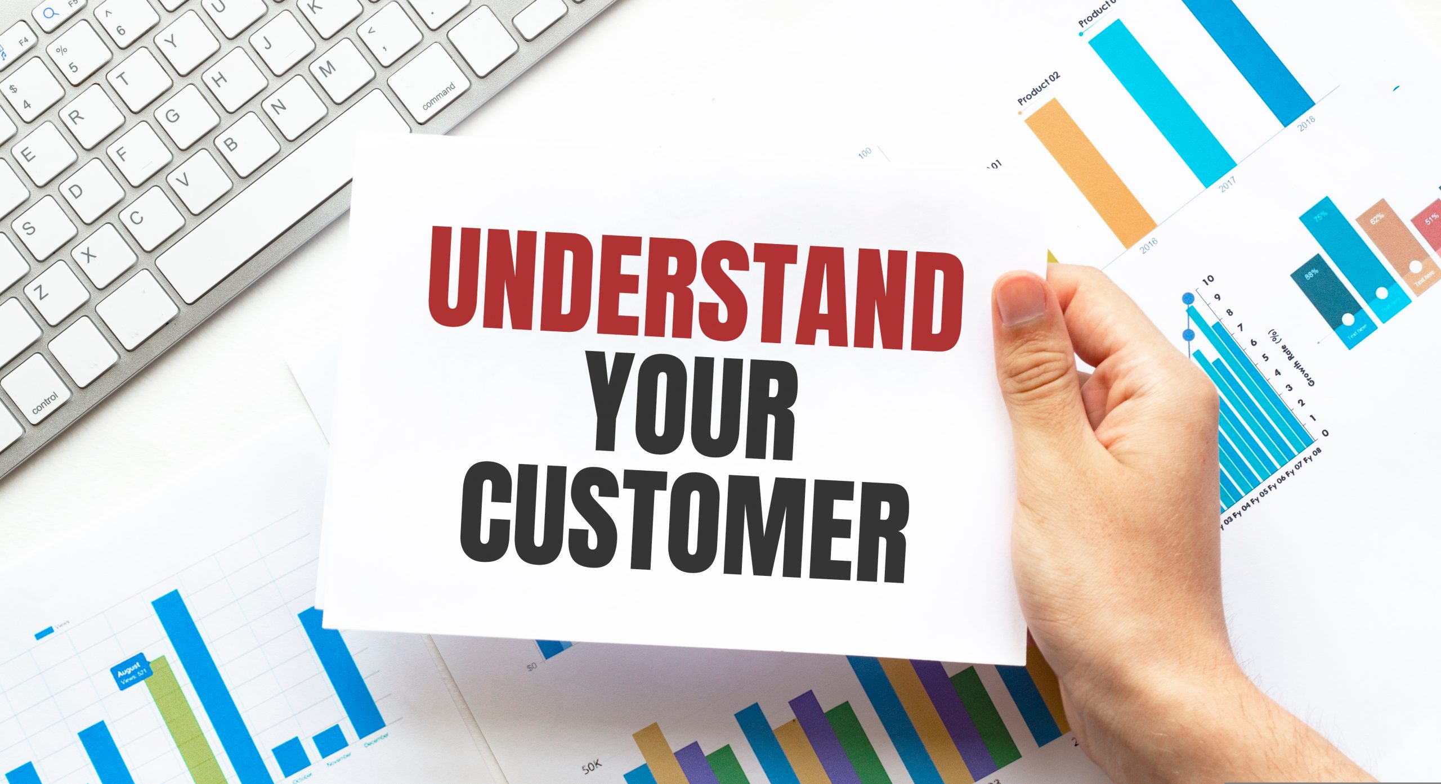
Best Practices (cont'd)
Conduct regular market research to understand evolving customer needs and preferences.
Engage with customers to gather feedback and insights that can inform value redefinition efforts.
Collaborate cross-functionally to align value propositions with organizational capabilities and market opportunities.
14
Notes:
Image source: https://criticalthinking.cloud/websites-tips/customer-needs-research-methods

Slide 16
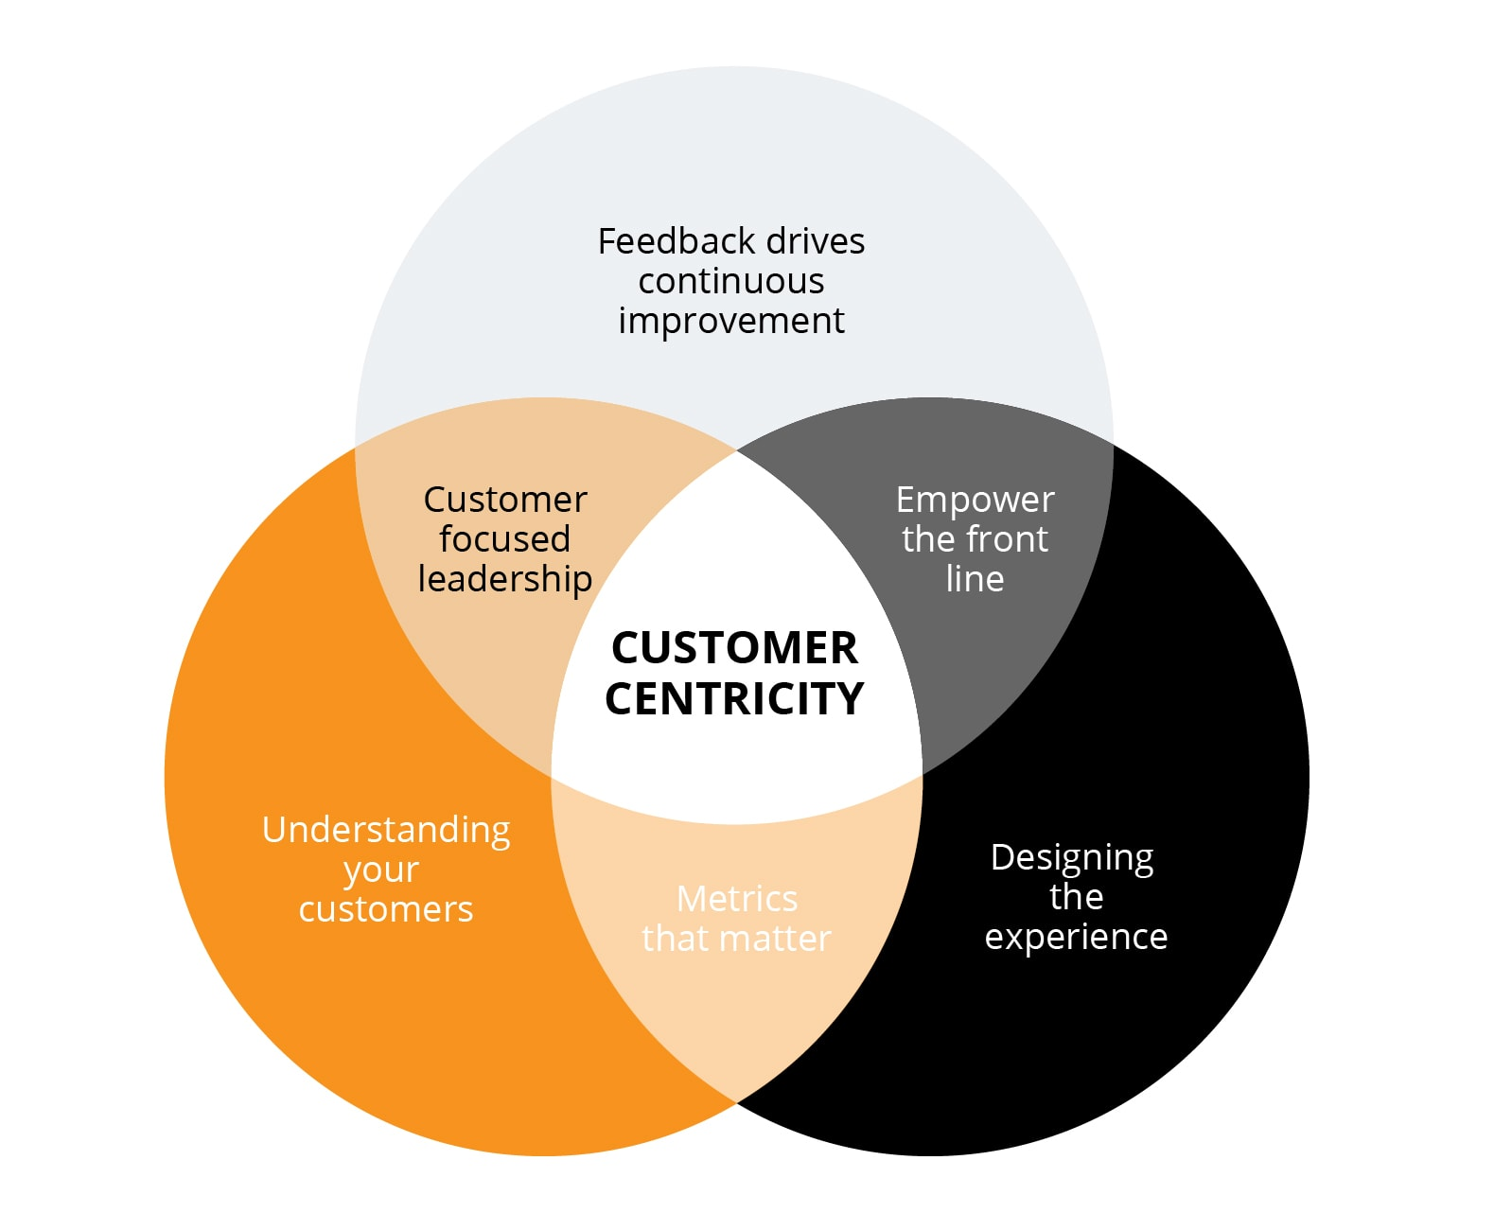
Best Practices (cont'd)
Prioritize customer-centric design principles in product and service development to create exceptional experiences.
Leverage data analytics and customer feedback to personalize experiences and drive customer engagement.
Continuously iterate and innovate on customer experiences to stay ahead of competitors and meet evolving expectations.
15
Notes:
Image source: https://www.future-processing.com/blog/what-really-matters-in-modern-customer-centric-design/

Slide 17
Best Practices (cont'd)
Establish standardized protocols and procedures to streamline operations and ensure consistency.
Involve employees in the standardization process to gain buy-in and identify opportunities for improvement.
Regularly review and update standardized practices to adapt to changing market conditions and emerging trends.
16
Notes:
Image source: https://checkflow.io/process-standardization

Slide 18
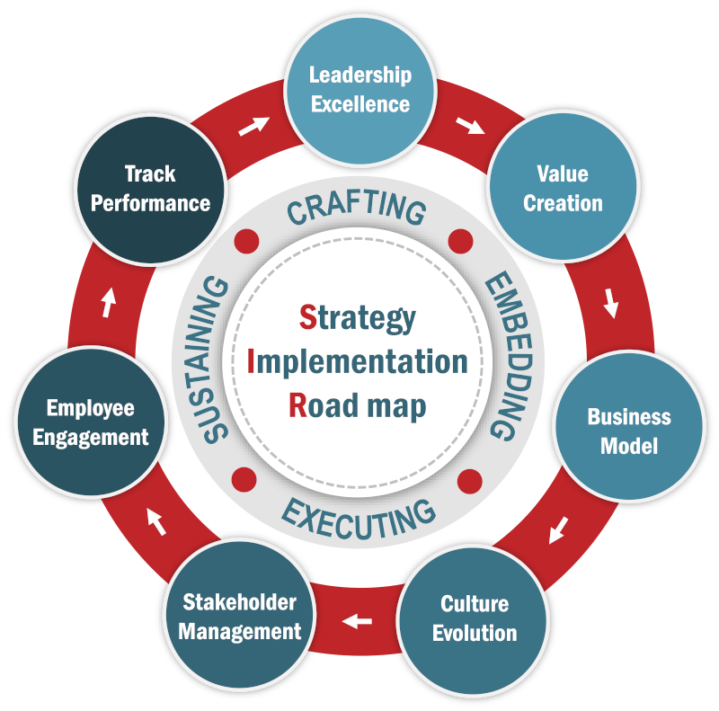
Implementation Strategies
Develop a roadmap for integrating maintenance relevance, value redefinition, extreme competition experience design, and standardization into organizational processes.
Identify key stakeholders and champions within the organization to drive implementation efforts and foster buy-in.
Communicate the importance of these concepts to employees at all levels and provide training and support to enable successful implementation.
17
Notes:
Image source: https://www.strategyimplementationinstitute.org/strategy-implementation-roadmap-sir/

Slide 19
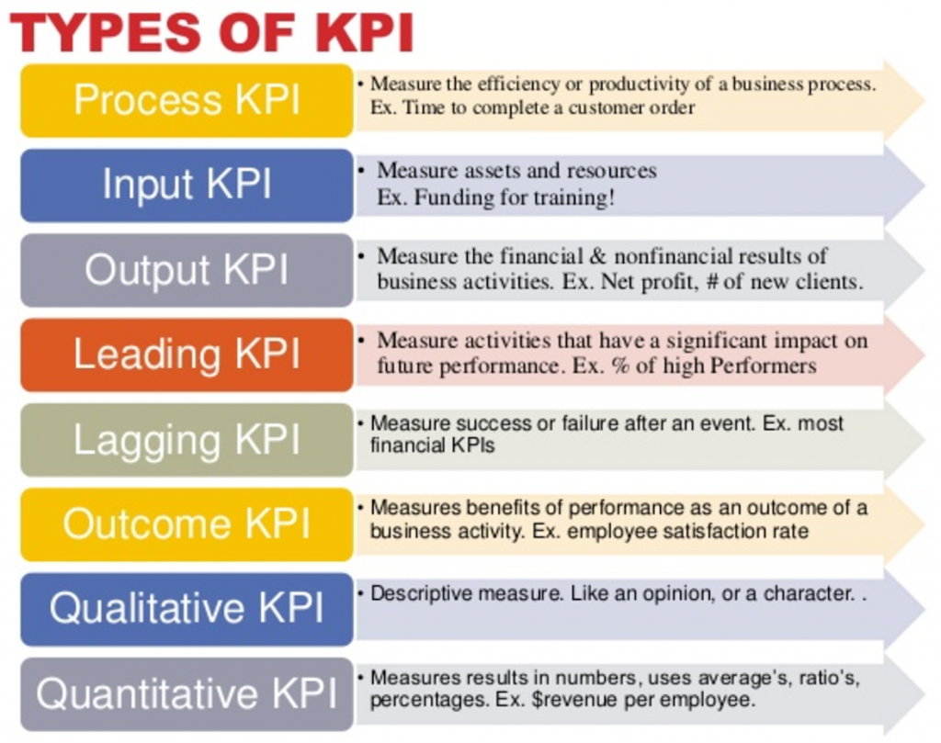
Measurement and Evaluation
Establish key performance indicators (KPIs) to measure the impact of maintenance relevance, value redefinition, extreme competition experience design, and standardization efforts.
Monitor KPIs regularly to track progress, identify areas for improvement, and make data-driven decisions.
Solicit feedback from customers, employees, and other stakeholders to evaluate the effectiveness of implemented strategies and make adjustments as needed.
18
Notes:
Image source: https://blog.apptians.com/digital-marketing/kpi-online-marketing-performance-indicators-types-definition-and-examples/

Slide 20

Conclusion
Maintenance relevance, value redefinition, extreme competition experience design, and standardization are essential concepts for staying competitive in today's business landscape.
By integrating these concepts and implementing best practices, organizations can drive innovation, enhance customer experiences, and achieve sustainable growth.
Embrace a culture of continuous improvement and adaptability to navigate the challenges and opportunities presented by extreme competition and evolving market dynamics.
19
Notes:
Image source: https://www.slidemake.com

Slide 21
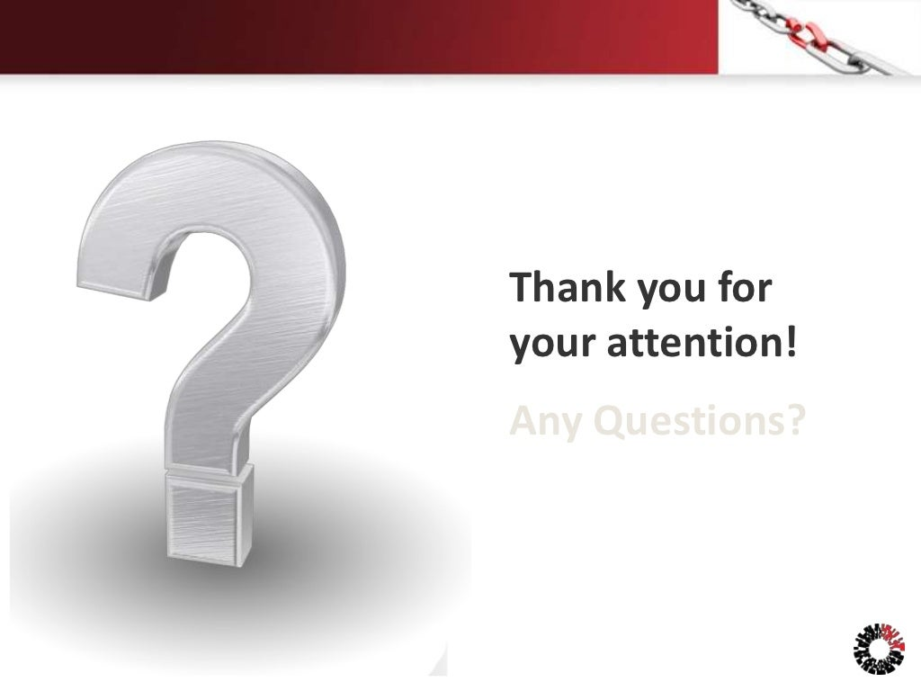
Thank You
Thank you for your attention. If you have any questions or would like to discuss further, please feel free to reach out.
Stay tuned for more insights and updates on maintenance relevance, value redefinition, extreme competition experience design, and standardization.
Remember, success in the modern business landscape requires a proactive and strategic approach to these critical concepts.
20
Notes:
Image source: http://www.slideshare.net/CyberAgency/social-engineering-13728812/39-Thank_you_foryour_attentionAny_Questions

